Slide 1


Lifeline Youth & Family Services
Presented by: Jennifer Sandman, Recruiting Specialist
Celebrating over 50 years of changing lives and making a true difference.
TITLE/HEADER
1

Slide 2

About Lifeline
Lifeline was created to be a beacon of hope to families who feel that they have nowhere else to turn.
Through in-home counseling, preventative education, and residential care, we give families the tools to be successful, meet their goals, and avoid future court intervention.
We are a faith-based organization, rooted in strong Christian values. We are committed to and we adhere to biblical teachings.
Lifeline Youth & Family Services
2

Slide 3



Home-Based Services
Residential
Education
Home-Based Services provides support for families throughout Indiana with therapeutic needs such as anger management, coping skills, identifying substance abuse, and trauma. We also help teach conflict resolution, problem solving, domestic violence awareness, healthy boundaries, communication, linking to community services, and more.
Pierceton Woods Academy is residential facility for boys who have been removed from their homes and placed with Lifeline through state agencies.
Project Incentive provides a free-of-charge preschool, parent outreach and home-based services to the residents of a low-income community in Fort Wayne.
Lifeline Youth & Family Services
Spencer Home provides safe, supervised environment to practice independent living skills, positioning them for future success.
2

Slide 4
Understanding the Need
The Indiana Department of Child Services received over 200,000 reports of child abuse and/or neglect in 2017.
That is an average of 547 calls per day from caring adults who have the self efficacy to report.
Lifeline currently is unable to serve more than
30 cases each week due to limited staffing.
How do we impact a need that is so great?
26%
Of children will witness or experience a traumatic event before they turn four years-old.
Lifeline Youth & Family Services
76%
Of children who experience multiple events before the age of three go on to have developmental delays.
2

Slide 5
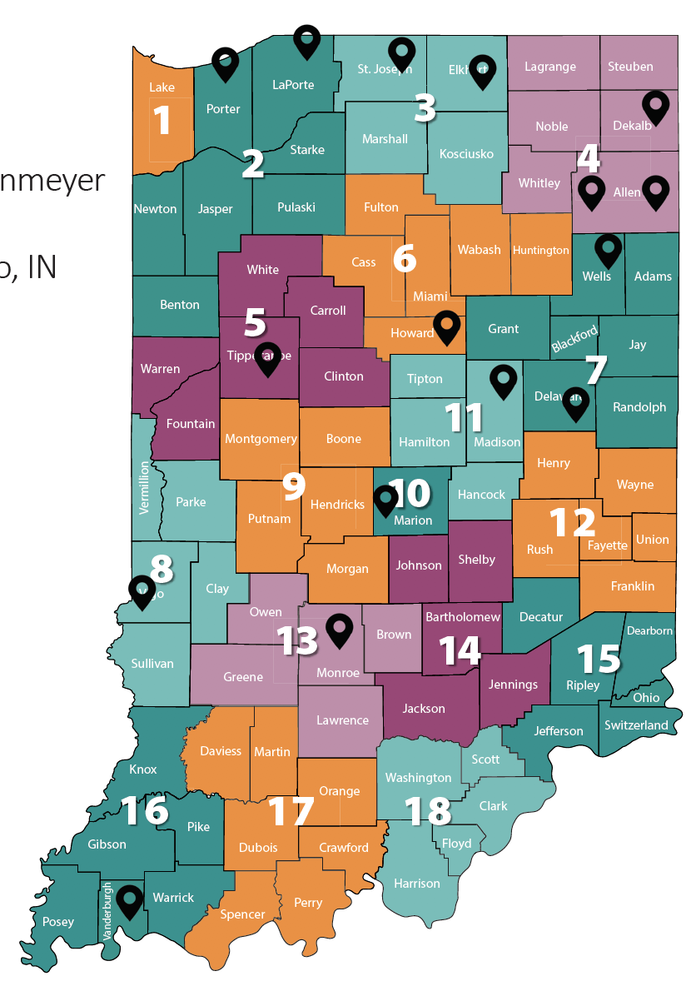
Serving Every County
We believe family is the foundation for success.
Our largest impact comes from meeting families’ unique needs by offering a variety of services.
We are serving clients for more
than 7,000 hours each week.
Lifeline Youth & Family Services
7,000
2

Slide 6
We are Difference Makers
Our programs work to restore emotional, mental and spiritual health, and then give families the tools they need to stay that way for the long-term.
It’s not just the child or individual family member in crisis who needs support and care, it’s the entire family. Our programs are built to support the individual, as well as the whole family. We believe that with family involvement, our chances of creating lasting change are exponentially greater.
Assessment of Need
Casework
Therapy
Homemaker Services
Monthly Reports
Full-family Involvement
Services in Client’s Homes
Visitation Supervision
Parent Engagement
24/7 Crisis Intervention
Lifeline Youth & Family Services
2

Slide 7




Lifeline Youth & Family Services
2

Slide 8
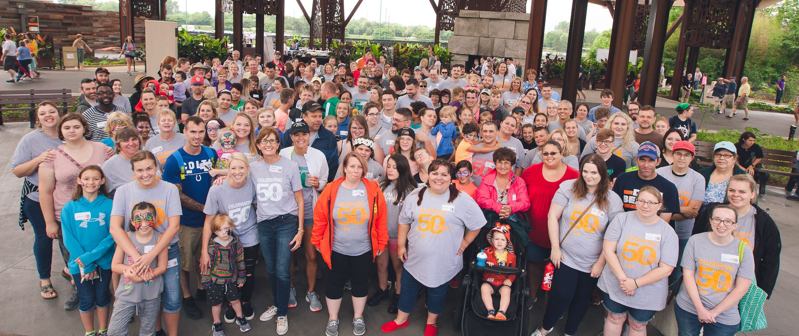
Opportunities
Family Consultants/Case Managers
Therapists
Regional Supervisors
Clinical Supervisors
Homebuilders Family Consultants
Visitation Specialists
Homemakers
Youth Treatment Specialists*
Program Coordinators *
Teachers*
Lifeline Youth & Family Services
FAMILIES MATTER | We mean it.
We’re not just in the business of helping restore families, we also want to help our own employee’s families. All supervisors are encouraged to promote a healthy work-life balance. From flexible schedules to an employee fund for emergencies, we make families a priority.
2

Slide 9

Why work for us?
Serving our communities
Foundation of faith
Opportunities for personal growth
Career Track
Tuition Assistance
Competitive pay
Benefits
Professional development
Mentors and staff with tenure
Clinical Licensure reimbursement
Continuing education & training
Supervision hours
CEU provider
Lifeline Youth & Family Services
Impact lives and help make a lasting change.
2

Slide 10


Let’s get started.
Lifeline Youth & Family Services
Connect with me: Jennifer Sandman
2

Slide 11



Connect with our organization:
facebook.com/lifelinefortwayne
LIFELINE YOUTH & FAMILY SERVICES
@lifelineyouthandfamily
@lifelineyouthandfamily
3
lastingchangestartshere.org • crosswinds.org • lifelineyouth.org

